Slide 1
Computer Networks CS 3001 (BCS-5B) Lecture 2
Danyal Farhat
FAST School of Computing
NUCES Lahore

Slide 2

Chapter 2 Application Layer
A note on the use of these PowerPoint slides:
We’re making these slides freely available to all (faculty, students, readers). They’re in PowerPoint form so you see the animations; and can add, modify, and delete slides (including this one) and slide content to suit your needs. They obviously represent a lot of work on our part. In return for use, we only ask the following:
If you use these slides (e.g., in a class) that you mention their source (after all, we’d like people to use our book!)
If you post any slides on a www site, that you note that they are adapted from (or perhaps identical to) our slides, and note our copyright of this material.
For a revision history, see the slide note for this page.
Thanks and enjoy! JFK/KWR
All material copyright 1996-2023
J.F Kurose and K.W. Ross, All Rights Reserved
Computer Networking: A Top-Down Approach 8th edition n Jim Kurose, Keith Ross Pearson, 2020

Slide 3

Application Layer: Overview
Principles of network applications
Web and HTTP
E-mail, SMTP, IMAP
The Domain Name System DNS

Slide 4
DNS: Domain Name System
people: many identifiers:
SSN, name, passport #
Internet hosts, routers:
IP address (32 bit) - used for addressing datagrams
“name”, e.g., cs.umass.edu - used by humans
Q: how to map between IP address and name, and vice versa ?
Domain Name System (DNS):
distributed database implemented in hierarchy of many name servers
application-layer protocol: hosts, DNS servers communicate to resolve names (address/name translation)
note: core Internet function, implemented as application-layer protocol
complexity at network’s “edge”

Slide 5
DNS: services, structure
DNS services:
hostname-to-IP-address translation
host aliasing
canonical, alias names
mail server aliasing
Runs over UDP and uses port 53
load distribution
replicated Web servers: many IP addresses correspond to one name
Q: Why not centralize DNS?
single point of failure
traffic volume
distant centralized database
maintenance
A: doesn‘t scale!
Comcast DNS servers alone: 600B DNS queries/day
Akamai DNS servers alone: 2.2T DNS queries/day

Slide 6

Thinking about the DNS
humongous distributed database:
~ billion records, each simple
handles many trillions of queries/day:
many more reads than writes
performance matters: almost every Internet transaction interacts with DNS - msecs count!
organizationally, physically decentralized:
millions of different organizations responsible for their records
“bulletproof”: reliability, security

Slide 7
DNS: a distributed, hierarchical database
Root DNS Servers
Root
…
…
.com DNS servers
.org DNS servers
.edu DNS servers
Top Level Domain
…
…
…
…
yahoo.com
DNS servers
amazon.com
DNS servers
pbs.org
DNS servers
nyu.edu
DNS servers
umass.edu
DNS servers
Authoritative
Client wants IP address for www.amazon.com; 1st approximation:
client queries root server to find .com DNS server
client queries .com DNS server to get amazon.com DNS server
client queries amazon.com DNS server to get IP address for www.amazon.com

Slide 8
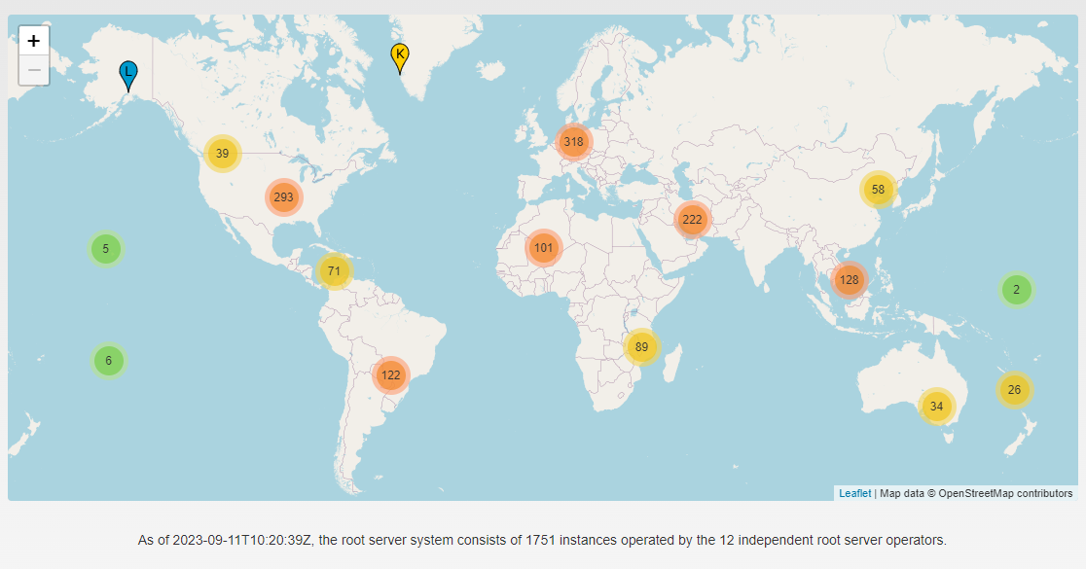
Root Servers Locations

Slide 9
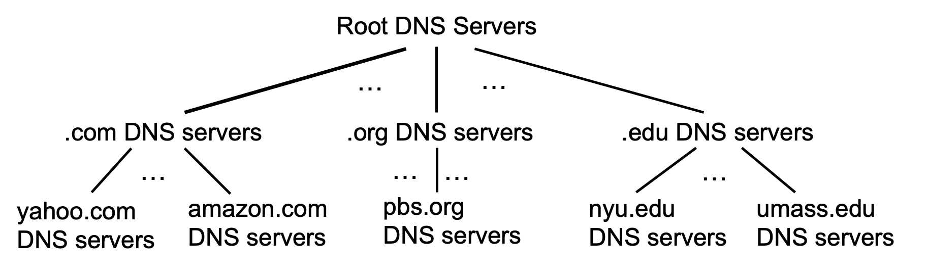
DNS: root name servers
official, contact-of-last-resort by name servers that can not resolve name

Slide 10
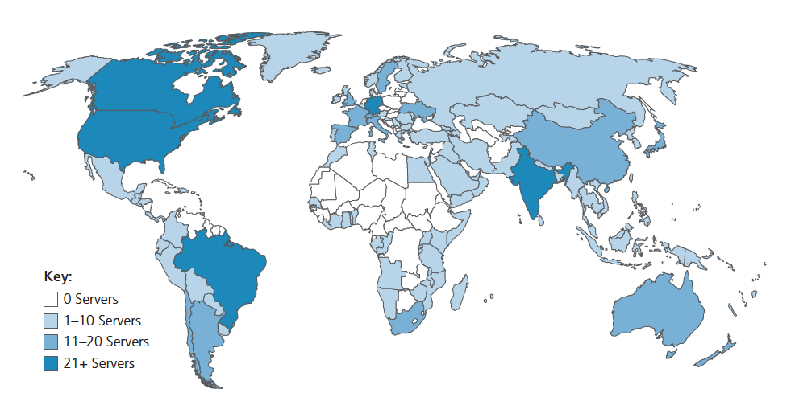
DNS: root name servers
official, contact-of-last-resort by name servers that can not resolve name
incredibly important Internet function
Internet couldn’t function without it!
DNSSEC – provides security (authentication, message integrity)
ICANN (Internet Corporation for Assigned Names and Numbers) manages root DNS domain
13 logical root name “servers” worldwide each “server” replicated many times (~200 servers in US)

Slide 11
Top-Level Domain, and authoritative servers
Top-Level Domain (TLD) servers:
responsible for .com, .org, .net, .edu, .aero, .jobs, .museums, and all top-level country domains, e.g.: .cn, .uk, .fr, .ca, .jp
Network Solutions: authoritative registry for .com, .net TLD
Educause: .edu TLD
authoritative DNS servers:
organization’s own DNS server(s), providing authoritative hostname to IP mappings for organization’s named hosts
can be maintained by organization or service provider

Slide 12
Local DNS name servers
when host makes DNS query, it is sent to its local DNS server
Local DNS server returns reply, answering:
from its local cache of recent name-to-address translation pairs (possibly out of date!)
forwarding request into DNS hierarchy for resolution
each ISP has local DNS name server; to find yours:
MacOS: % scutil --dns
Windows: >ipconfig /all
local DNS server doesn’t strictly belong to hierarchy

Slide 13

DNS name resolution: iterated query
root DNS server
Example: host at engineering.nyu.edu wants IP address for gaia.cs.umass.edu
2
3
TLD DNS server
Iterated query:
contacted server replies with name of server to contact
“I don’t know this name, but ask this server”
1
4
8
5
requesting host at
engineering.nyu.edu
local DNS server
dns.nyu.edu
gaia.cs.umass.edu
7
6
authoritative DNS server
dns.cs.umass.edu

Slide 14
DNS name resolution: recursive query
root DNS server
Example: host at engineering.nyu.edu wants IP address for gaia.cs.umass.edu
2
3
7
6
Recursive query:
puts burden of name resolution on contacted name server
heavy load at upper levels of hierarchy?
1
TLD DNS server
8
requesting host at
engineering.nyu.edu
local DNS server
dns.nyu.edu
5
4
gaia.cs.umass.edu
authoritative DNS server
dns.cs.umass.edu

Slide 15
Caching DNS Information
once (any) name server learns mapping, it caches mapping, and immediately returns a cached mapping in response to a query
caching improves response time
cache entries timeout (disappear) after some time (TTL)
TLD servers typically cached in local name servers
cached entries may be out-of-date
if named host changes IP address, may not be known Internet-wide until all TTLs expire!
best-effort name-to-address translation!

Slide 16
DNS records
DNS: distributed database storing resource records (RR)
RR format: (name, value, type, ttl)
type=A
name is hostname
value is IP address
type=CNAME
name is alias name for some “canonical” (the real) name
www.ibm.com is really servereast.backup2.ibm.com
value is canonical name
type=NS
name is domain (e.g., foo.com)
value is hostname of authoritative name server for this domain
type=MX
value is name of SMTP mail server associated with name

Slide 17
DNS protocol messages
DNS query and reply messages, both have same format:
2 bytes
2 bytes
message header:
identification: 16 bit # for query, reply to query uses same #
flags:
query or reply
recursion desired
recursion available
reply is authoritative
identification
flags
# questions
# answer RRs
# authority RRs
# additional RRs
questions (variable # of questions)
answers (variable # of RRs)
authority (variable # of RRs)
additional info (variable # of RRs)

Slide 18
DNS protocol messages
DNS query and reply messages, both have same format:
2 bytes
2 bytes
identification
flags
# questions
# answer RRs
# authority RRs
# additional RRs
name, type fields for a query
questions (variable # of questions)
RRs in response to query
answers (variable # of RRs)
records for authoritative servers
authority (variable # of RRs)
additional “ helpful” info that may be used
additional info (variable # of RRs)

Slide 19
Getting your info into the DNS
example: new startup “Network Utopia”
register name networkuptopia.com at DNS registrar (e.g., Network Solutions)
provide names, IP addresses of authoritative name server (primary and secondary)
registrar inserts NS, A RRs into .com TLD server:
(networkutopia.com, dns1.networkutopia.com, NS)
(dns1.networkutopia.com, 212.212.212.1, A)
create authoritative server locally with IP address 212.212.212.1
type A record for www.networkuptopia.com
type MX record for networkutopia.com

Slide 20
DNS security
DDoS attacks
bombard root servers with traffic
not successful to date
traffic filtering
local DNS servers cache IPs of TLD servers, allowing root server bypass
bombard TLD servers
potentially more dangerous
Spoofing attacks
intercept DNS queries, returning bogus replies
DNS cache poisoning
RFC 4033: DNSSEC authentication services

Slide 21
Chapter 2: Summary
our study of network application layer is now complete!
application architectures
client-server
P2P
application service requirements:
reliability, bandwidth, delay
Internet transport service model
connection-oriented, reliable: TCP
unreliable, datagrams: UDP
specific protocols:
HTTP
SMTP, IMAP
DNS

Slide 22
Chapter 2: Summary
Most importantly: learned about protocols!
typical request/reply message exchange:
client requests info or service
server responds with data, status code
message formats:
headers: fields giving info about data
data: info(payload) being communicated
important themes:
centralized vs. decentralized
stateless vs. stateful
scalability
reliable vs. unreliable message transfer
“complexity at network edge”

Slide 23
Thank You!

